Slide 1

What is Data Science?
Business problem, ask questions to understand why you are doing this and for what.
Data acquisition, gather all the data from different sources i.e., web servers, logs, databases, API’s and online repositories
Data preparation, data cleaning and transformation. Remove inconsistent datatypes, misspelled attributes, missing and duplicate values. Then transform the data with tools like Informatica, so you can understand the data structure better.
Exploratory data analysis. With the help of EDA, you can define and refine the selection of feature variable that will be used in the model development. Most important step, because without this you get an incorrect model.
Data modeling. Identify the model that best fits the business requirement with the help of i.e. KNN, Naïve Bayes or decision trees. Then train the models on the training dataset and test them. Then select the best performing model like python.
Visualization and communication. Use tools like Power BI to make i.e., dashboard to show the data to convince the stakeholders.
Deploys and maintains. Test the model before deploying it. After the deployment use repo’s/dashboards to get real time analytics. After that you can maintain the deployment environment.
By: Jorik Leemans

Slide 2
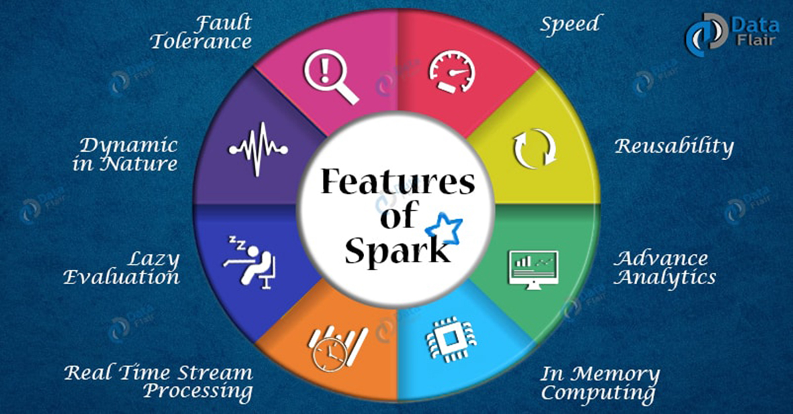
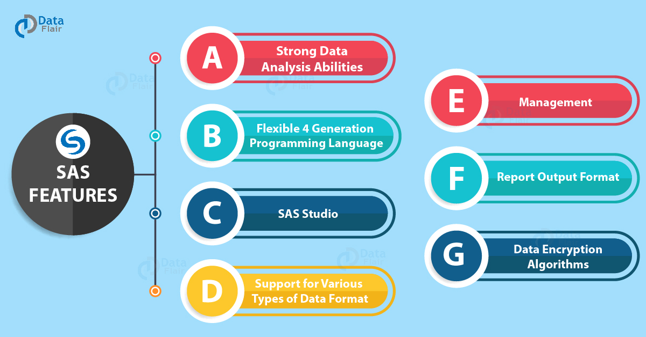
What are the most popular data science tools?
SAS
Apache Spark
BigML
MATLAB
Excel
Jupyter
By: Jorik Leemans

